Slide 1

Senior Design Project I
Week 5: Deciding on Project Focus
Presenter: Josheb P. Dayrit

Slide 2

Project Focus
Overview
ASL gestures (qualitative data) will be transformed into analog signals (quantitative data) by electrical and mechanical sensors.
Each gesture, at present, is assumed to produce unique signals, which allows their telling-apart.

Slide 3
Project Focus
Data Acquisition? Signal Processing?
Signals are tricky. They attenuate with distance and they distort when interfered with (noise, crosstalk).
Spectrograms can be messy to look at, and often, you need to apply filters to extract important parts of the incoming signal.
Signal processing will not be my focus.

Slide 4
Project Focus
AI? Again?
Yes, training a convolutional AI (one that specializes in image – and, by extension, signal – processing) is going to be the project focus.
Once trained, the AI is expected to recognize patterns in the signal data of different ASL gestures.
Getting clear signal data is important.

Slide 5
Resources (Sensors)
For Surface Electromyography (sEMG)
MyoWare Muscle Sensor: an Arduino-compatible sensor.
Developed by Advancer Technologies.

Slide 6
MyoWare Sensor

Slide 7
Resources (Sensors)
MyoWare Muscle Sensor
The pros:
comparatively cheap ($37 vs $200+),
Has 2 output modes: EMG envelope and raw EMG,
Has a wearable design.
Notes:
Talk about signal envelope.

Slide 8
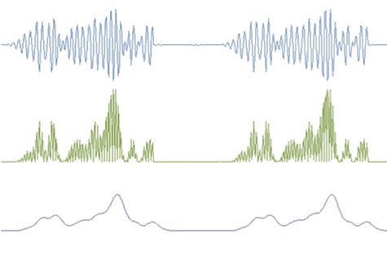
MyoWare Signal Processing
Raw EMG
Rectified EMG
EMG Envelope
Notes:
Talk about signal envelope.

Slide 9
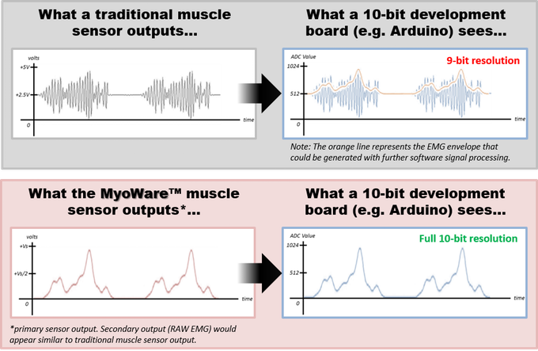
MyoWare Signal Processing
Notes:
Talk about signal envelope.

